Slide 1
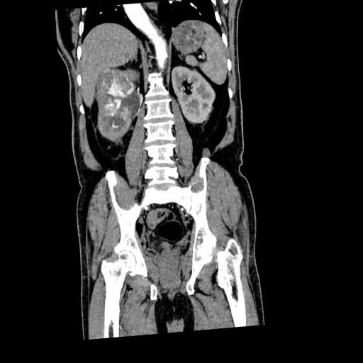

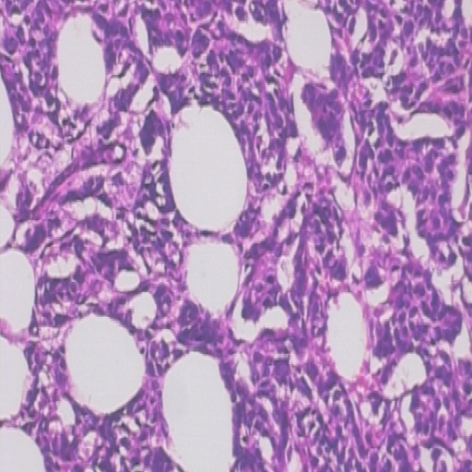
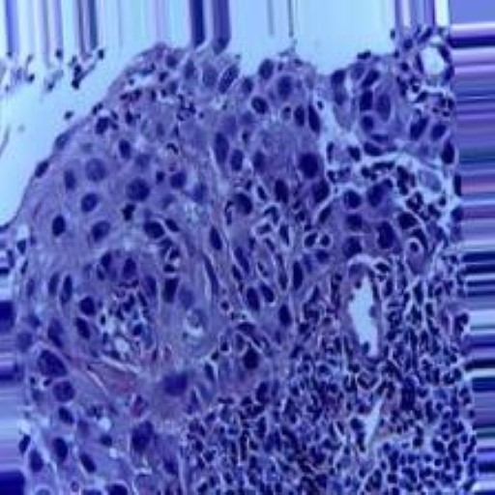

Multi cancer dataset
Line Scheuer, Sham Ayrouta and Valdemar Lund-Frank
Multi cancer dataset
Valdemar, Sham og Line
11/6 -25

Slide 2
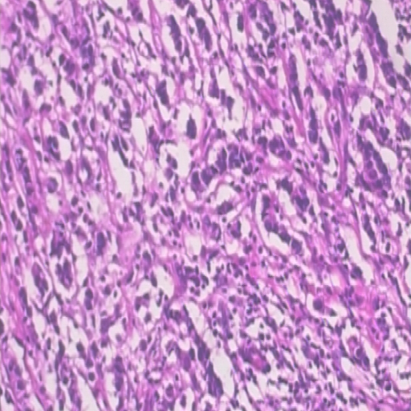
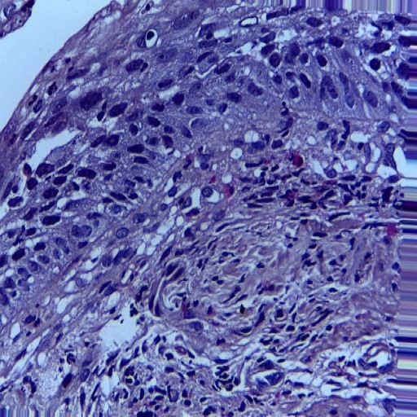
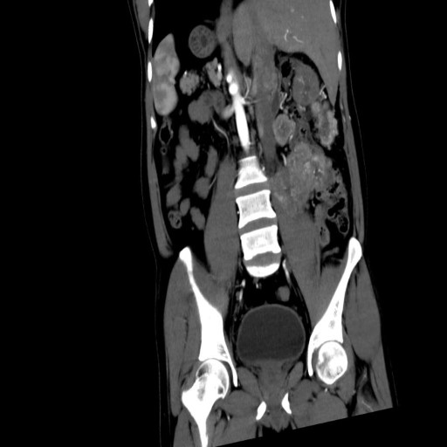
Multi cancer dataset
Line Scheuer, Sham Ayrouta and Valdemar Lund-Frank
3 datasets
(Breast, Oral and Kidney)
The data
Breast cancer
Oral cancer
Binary label
30000 data entries
(each dataset 10000 entries)
Cancer or healthy cells
Images
(biopsies/scans)
Data pre-processing: 512x512 → 224x224
Kidney cancer

Slide 3
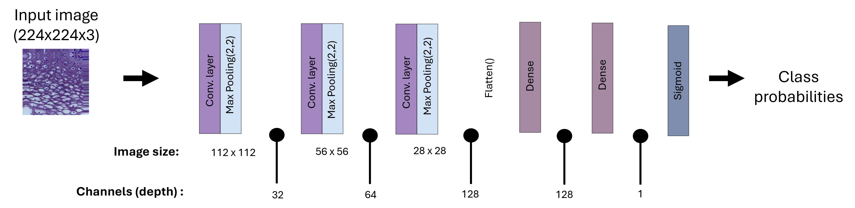
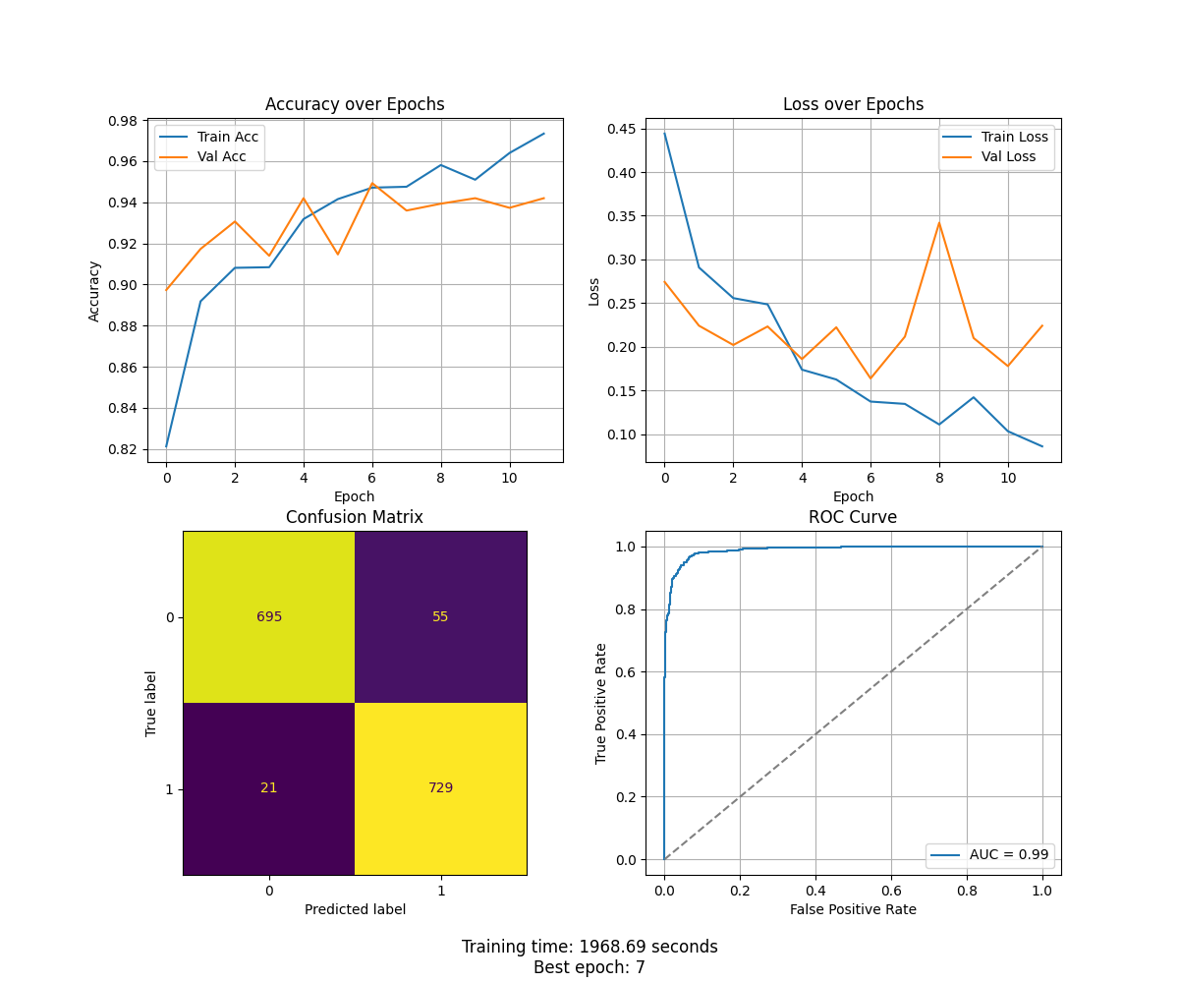
Initial CNN
Multi cancer dataset
Line Scheuer, Sham Ayrouta and Valdemar Lund-Frank
Hyper parameters:
Dropout-rate = 0.5
Learning rate = 0.001
Early stopping with patience = 5
 | Val accuracy | Val loss | AUC | Epochs | Training time
Oral | 0.5 | 0.693 | 0.50 | 6 | 1823.80 s
Breast | 0.95 | 0.170 | 0.99 | 7 | 1968.60 s
Kidney | 1.0 | 0 | 1.00 | 6 | 1594.03 s
Figure: Results for the breast cancer data set

Slide 4
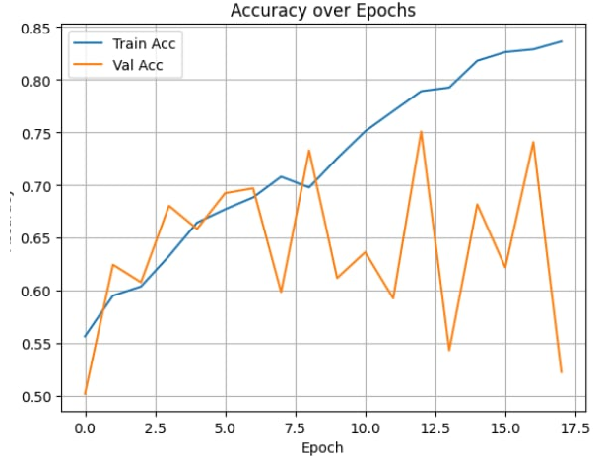
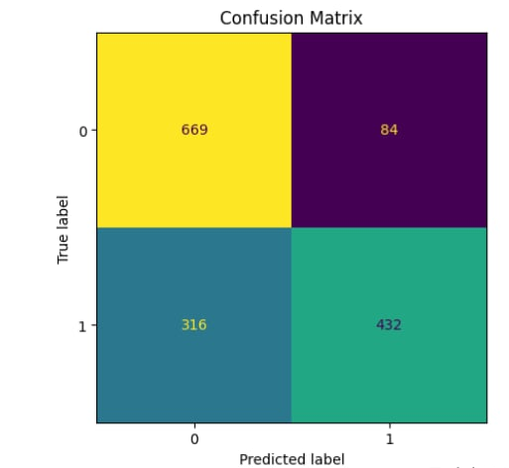
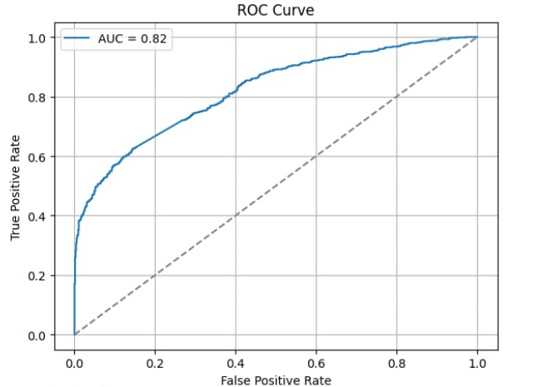
Multi cancer dataset
Line Scheuer, Sham Ayrouta and Valdemar Lund-Frank
Group shuffle split the data
Realistic results on oral cancer dataset with AUC = 0.82
Perfect (not realistic) results on kidney cancer dataset with AUC = 1
Figures: Results for the oral cancer data set

Slide 5
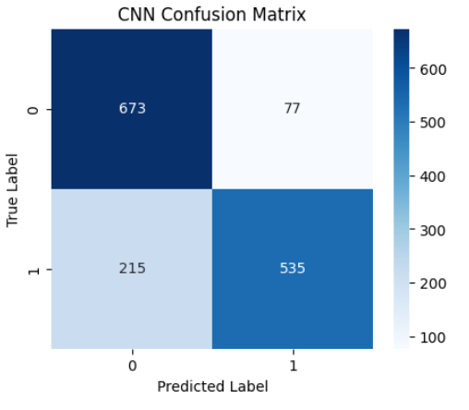
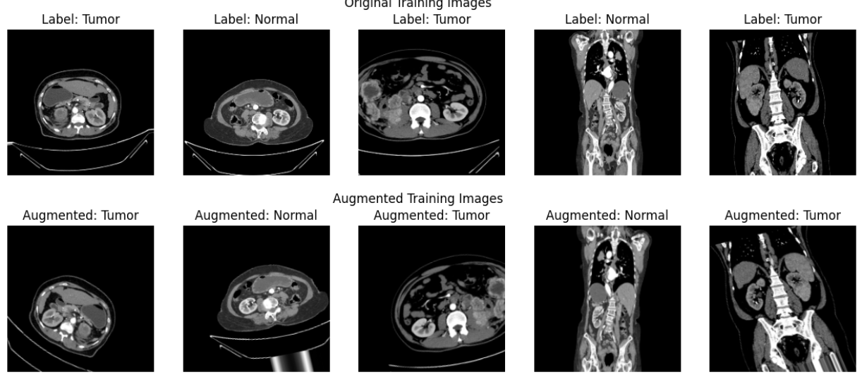
Multi cancer dataset
Line Scheuer, Sham Ayrouta and Valdemar Lund-Frank
Data augmentation on kidney cancer data
Lower performance, but more realistic model behaviour
AUC = 0.92
Figures: Results for the kidney cancer data set

Slide 6
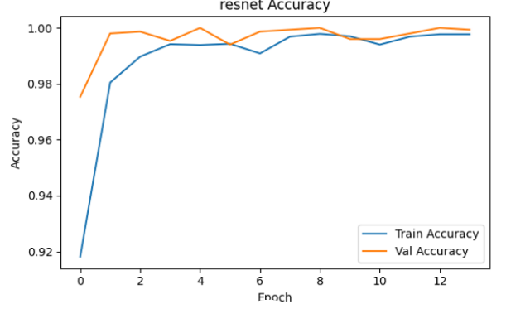
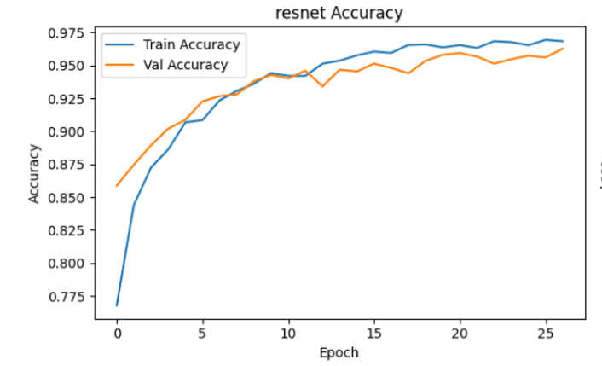
Multi cancer dataset
Line Scheuer, Sham Ayrouta and Valdemar Lund-Frank
Foundation model ”ResNet50”
Results for kidney cancer:
AUC= 1 & accuracy 1
Results for oral cancer:
AUC 0.99 & accuracy 0.95
Longer training time ~79 min

Slide 7
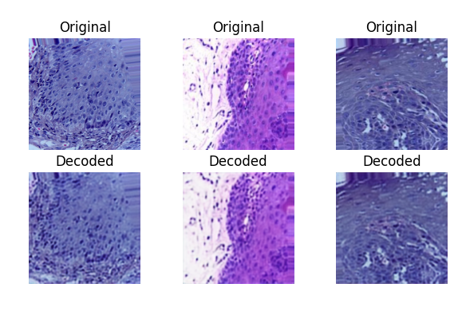
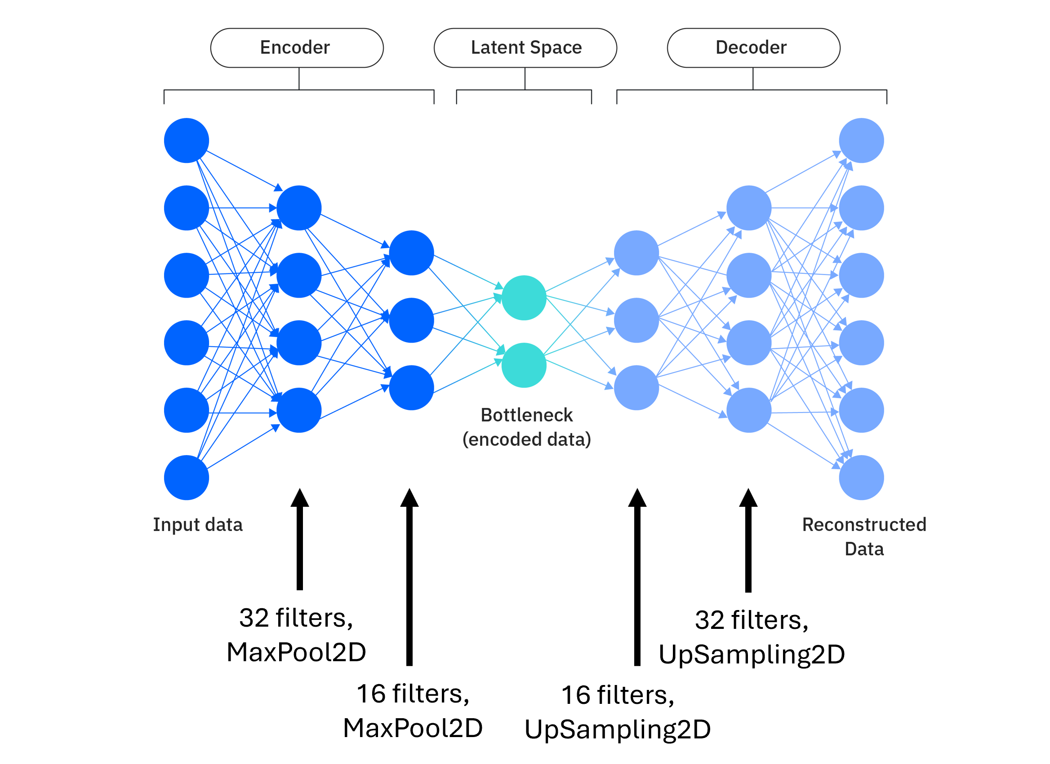
Auto-encoding the images
Multi cancer dataset
Line Scheuer, Sham Ayrouta and Valdemar Lund-Frank
Figure: Original and decoded images for the oral cancer data set
 | Val accuracy | Val loss | AUC | Epochs | Training time
Oral | 0.50 → 0.86 | 0.69 → 0.30 | 0.50 → 0.95 | 6 → 11 | 1823.8 s → 102.2 s
Breast | 0.95 → 0.96 | 0.17 → 0.11 | 0.99 → 0.99 | 7 → 16 | 1968.6 s → 141.1 s
Kidney | 1.0 → 0.98 | 0 → 0.20 | 1.0 → 0.99 | 6 → 13 | -
Trained on 2000 randomly chosen images out of 10000
Original image: (224, 224, 3) → latent space: (56, 56, 16)

Slide 8
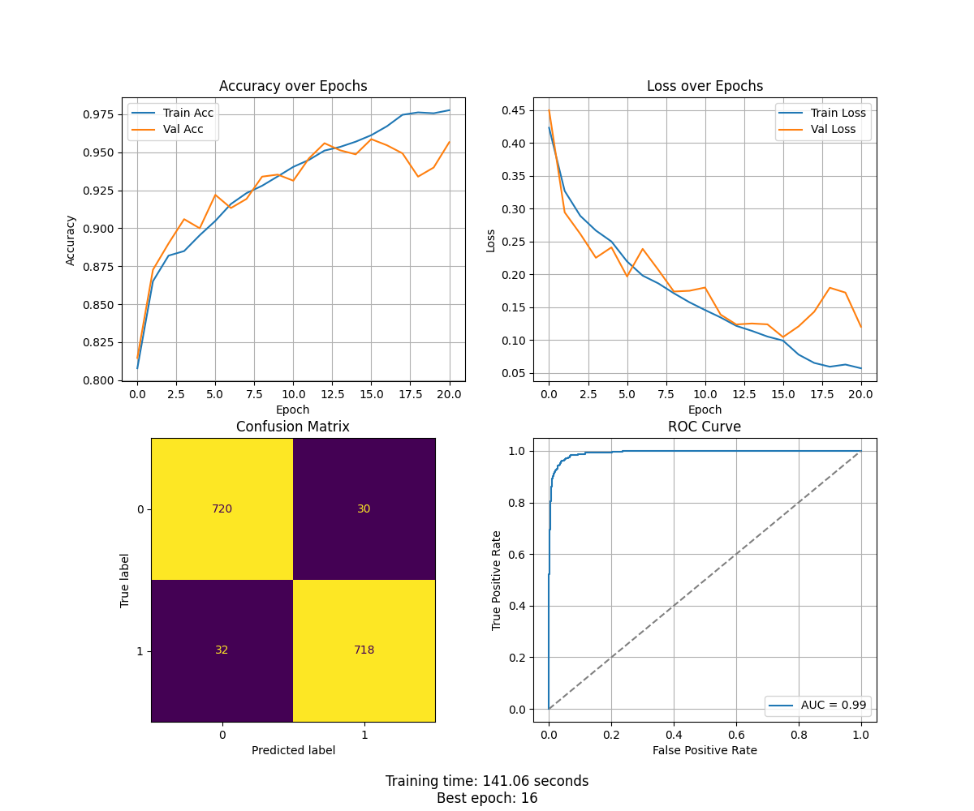
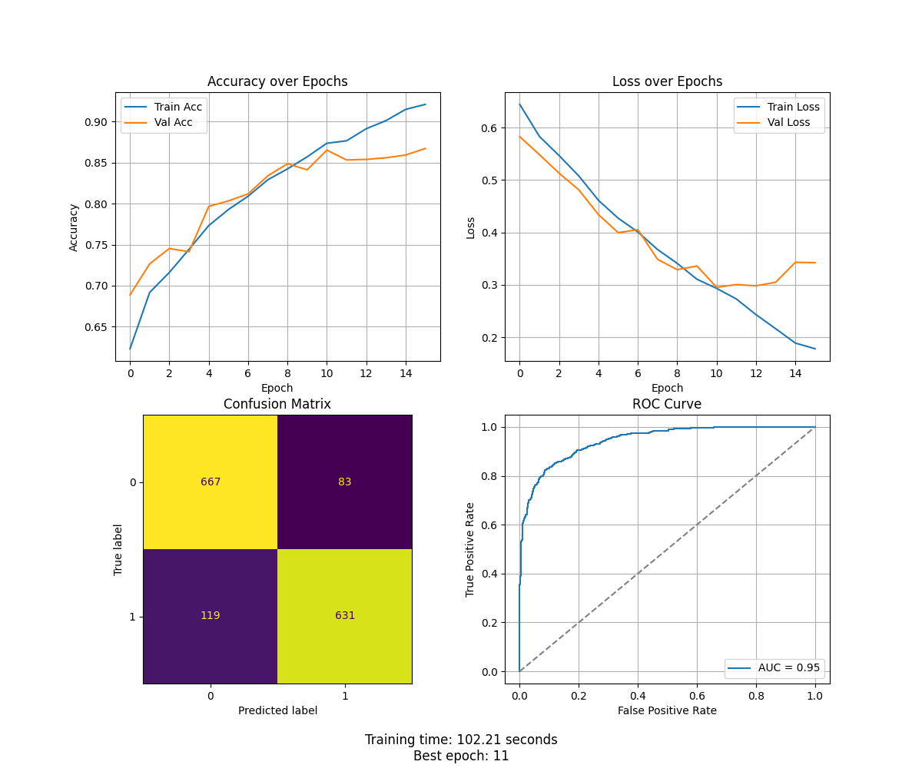
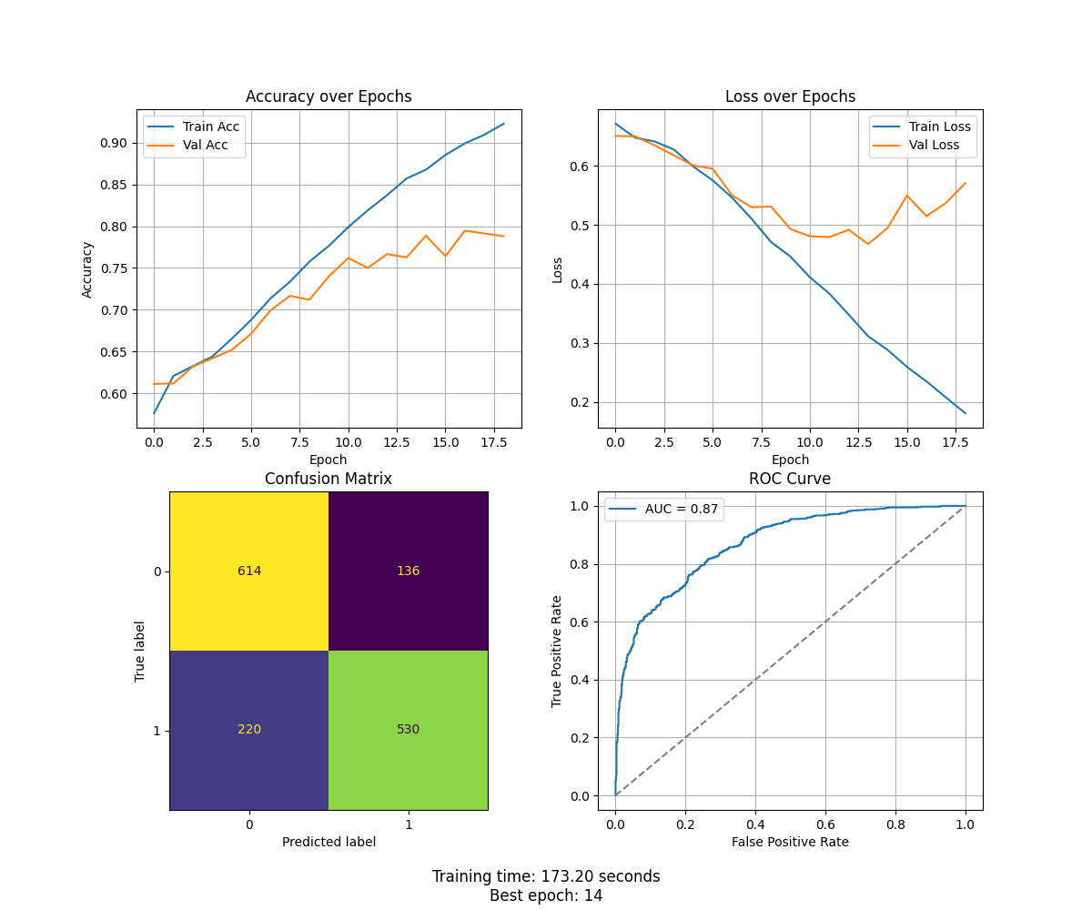
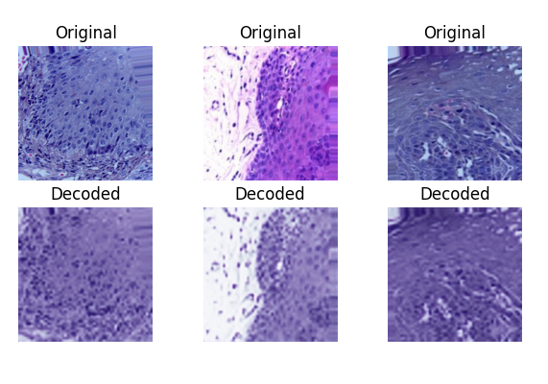
Introducing a dense layer to the auto encoder on oral cancer data
Multi cancer dataset
Line Scheuer, Sham Ayrouta and Valdemar Lund-Frank
Reduced training time significantly!
Captured important features to make model on oral cancer data learn
Healthier training process for breast cancer data.
Figures: Loss curves for the breast cancer dataset
Without dense layer
With dense layer

Slide 9

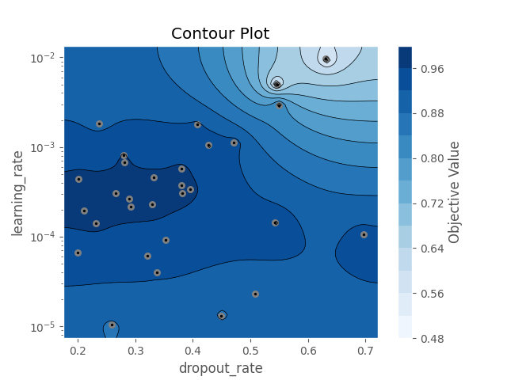
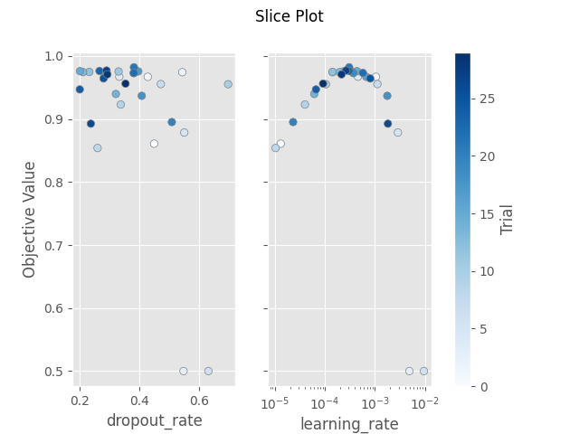
Hyperparameter optimization on encoded oral cancer data
Multi cancer dataset
Line Scheuer, Sham Ayrouta and Valdemar Lund-Frank
Learning rate = 0.0003
Dropout rate = 0.38

Slide 10
Multi cancer dataset
Line Scheuer, Sham Ayrouta and Valdemar Lund-Frank
Feature importance on breast cancer data
Grad-Cam
Calculates gradient of each activation map and compares to the output score. The gradient for each activation map is the weight for a final activation map.
Score-Cam
Use each activation map and mask on the image to feed to the model for a predicted score. Use scores as weights for each activation map to compute on final activation map.
Three convolutional layers
First layer edges and texture, whereas final layer depicts information with impact.
No idea what the cancer looks like, therefore no clue if cancer is marked.
Need to do it in collaboration with pathologist.

Slide 11
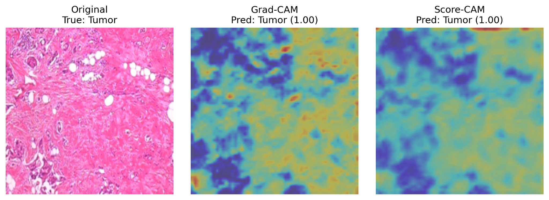
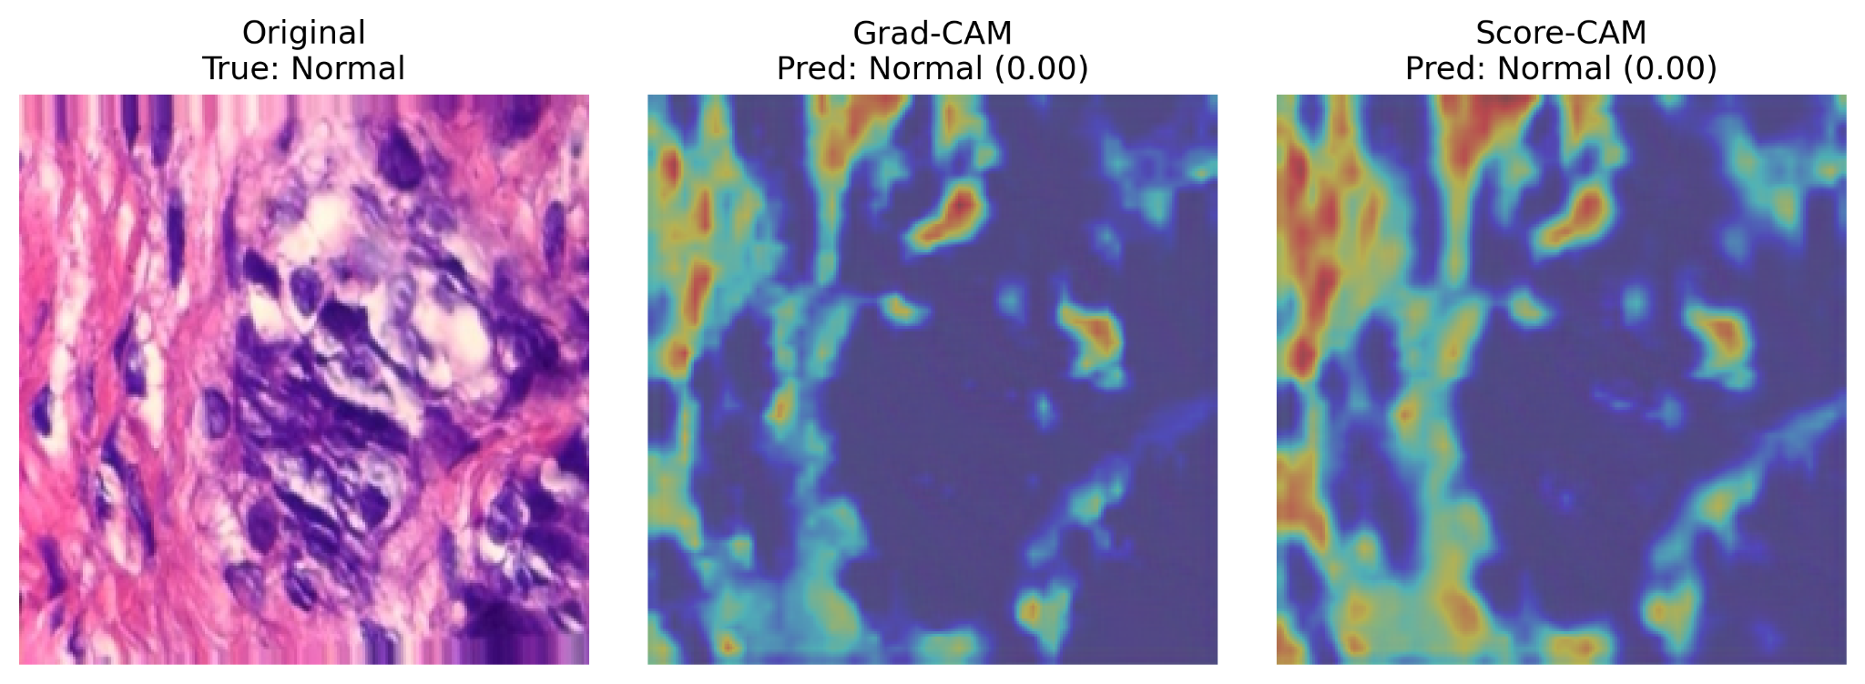
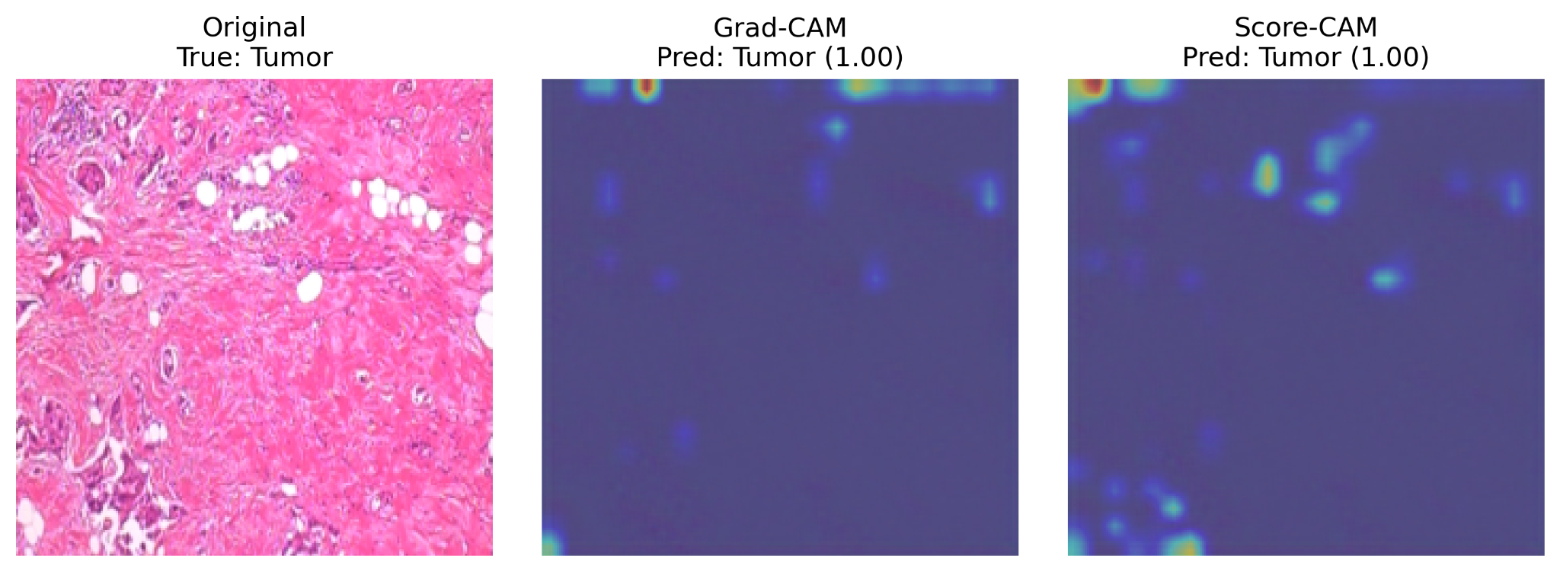
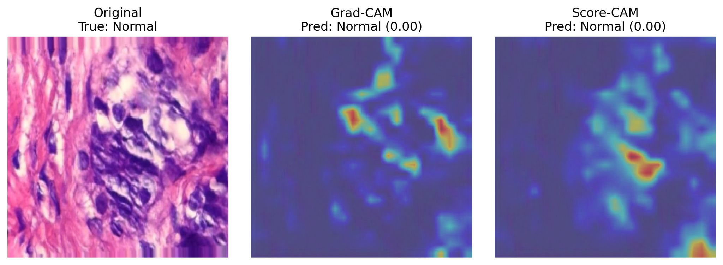
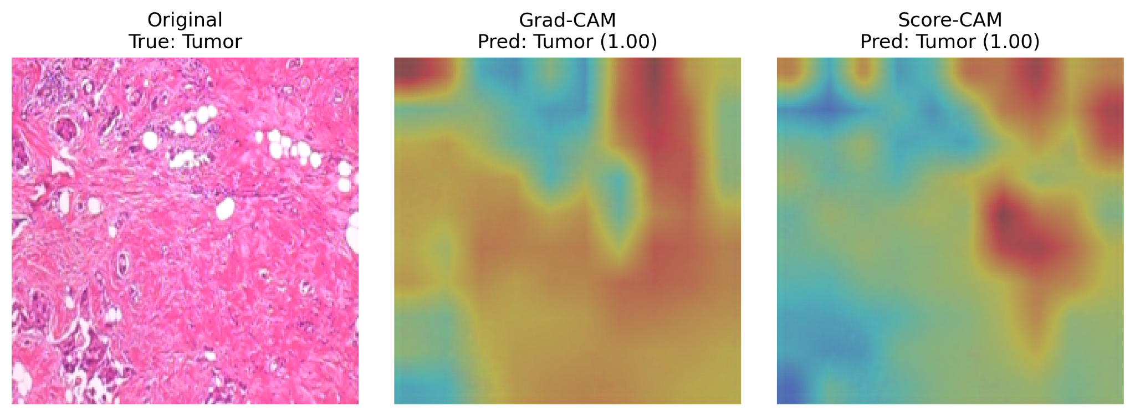
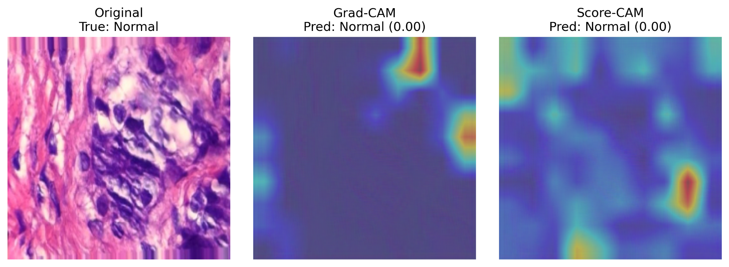

Slide 12
Multi cancer dataset
Line Scheuer, Sham Ayrouta and Valdemar Lund-Frank
Three best models – for us and our computers
Oral data
Kidney data
Breast data
Auto Encoding
Data augmentation
Auto Encoding
Bayesian opt.
Basic CNN
Basic CNN
Basic CNN
Evaluation
Evaluation
Evaluation
AUC: 0.92
Accuracy: 0.7
Runtime: 507 s
AUC: 0.99
Accuracy: 0.96
Runtime: 141.06 s
AUC: 0.98
Accuracy: 0.92
Runtime: 180.96 s

Slide 13
Multi cancer dataset
Line Scheuer, Sham Ayrouta and Valdemar Lund-Frank
Conclusions
We made three successful CNN models for classification
Visualised important features with Grad-cam and Score-cam
The optimal model depends on the dataset (Greyscale vs. colored images)
“Fast computers breed lazy programmers” - in this case our computers were not fast enough therefore we were very aware of runtime and optimization

Slide 14

Thank you for listening!
Scan for access to github with code and a few results

Slide 15
Appendix
Multi cancer dataset
Line Scheuer, Sham Ayrouta and Valdemar Lund-Frank

Slide 16

Final model
Multi cancer dataset
Line Scheuer, Sham Ayrouta and Valdemar Lund-Frank
512x512
10000 images
Data
Group-shuffle-split
Data augmentation
Optimal model in context with infinite time and computer power
Auto encoding
Learning rate
Drop out
Bayesian opt.
Early stopping
Cross validation
Resnet 50
Standard model
Accuracy, Loss function,
Confusion matrix, AUC,
Run time
Evaluation

Slide 17
Initial CNN
The first thing we did was to try and run a basic CNN model on each of our three datasets. The model was:
Input: Raw images of shape (224, 224, 3) (color) or (224, 224, 1) (greyscale)
Architecture:
3 × [Conv2D + ReLU + MaxPooling2D] blocks with filters (32, 64 and 128)
Flatten → Dense (128, ReLU) → Dropout
Output layer: Dense(1, Sigmoid) for binary classification
Training:
Optimizer: Adam (learning rate = 0.001)
Loss: Binary cross-entropy
Metrics: Accuracy & AUC
Early stopping on validation loss (patience = 5)
Batch size: 32
Max epochs: 30
Performance tracking:
Validation loss and accuracy curves
ROC-curve and AUC
Confusion matrix
Best epoch selected by lowest val_loss
Training time recorded

Slide 18
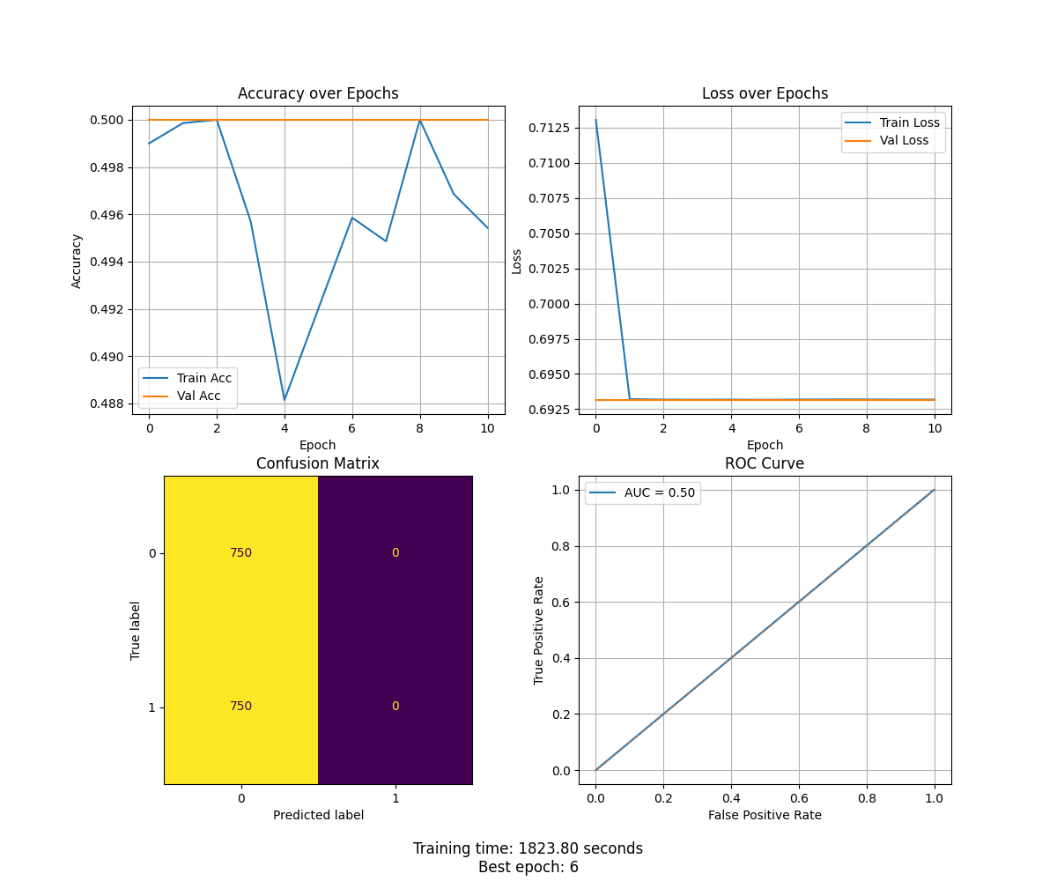
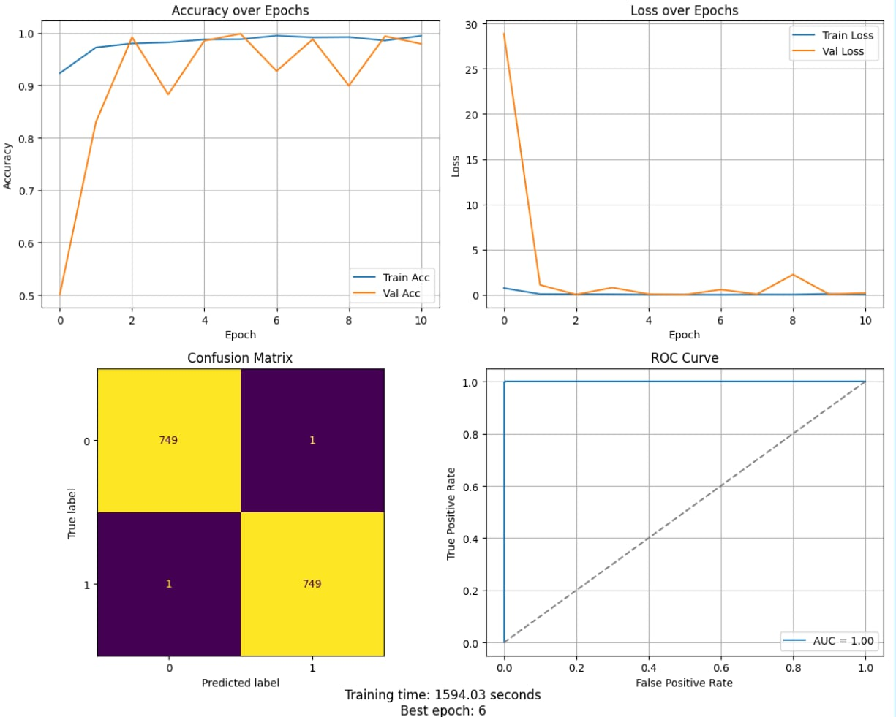
Initial CNN results
Multi cancer dataset
Line Scheuer, Sham Ayrouta and Valdemar Lund-Frank
Oral
Breast
Kidney
AUC: 0.50
Training time: 1823.80 sec
Best epoch: 6
AUC: 0.99
Training time: 1968.69 sec
Best epoch: 7
AUC: 1.00
Training time: 1594.03 sec
Best epoch: 6

Slide 19
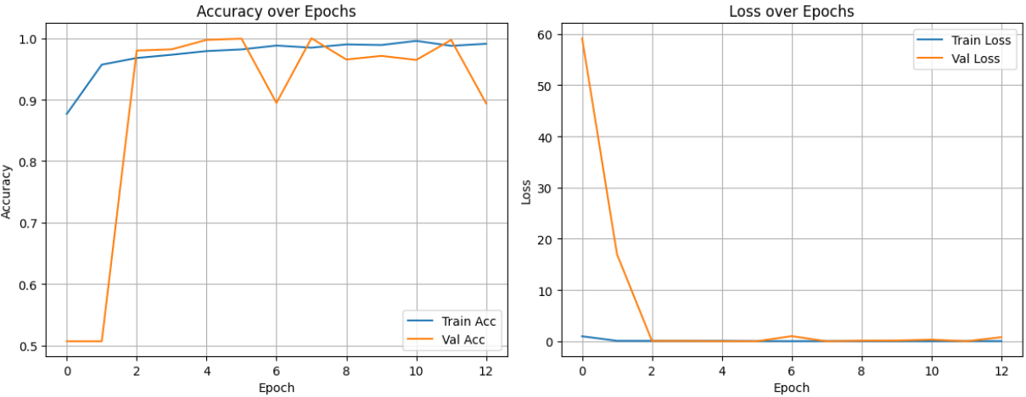
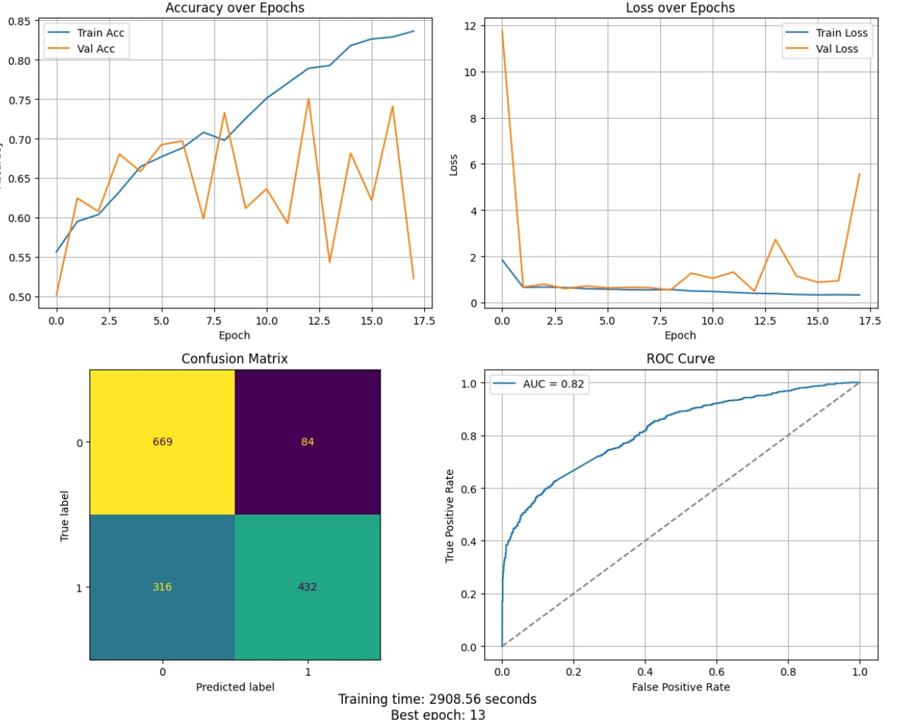
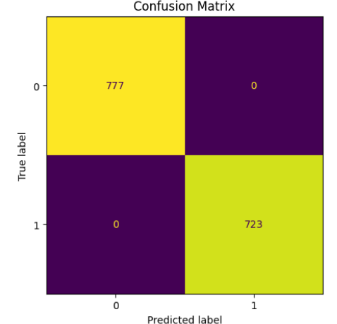
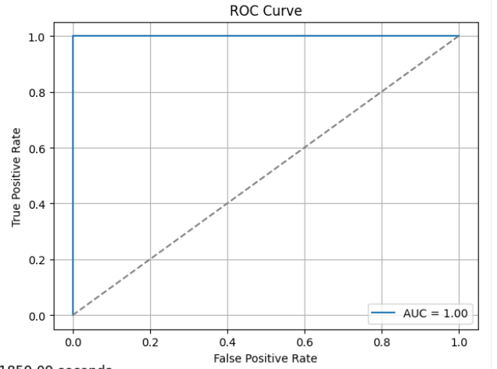
Group shuffle split
Multi cancer dataset
Line Scheuer, Sham Ayrouta and Valdemar Lund-Frank
Due to poor initial results on both the kidney and oral datasets, we tried implementing group shuffle split of our data instead of using the classic test_train_split to avoid possible data leakage. The same CNN model was trained on the newly split data:
Kidney
Oral
AUC: 1.00
AUC: 0.82

Slide 20
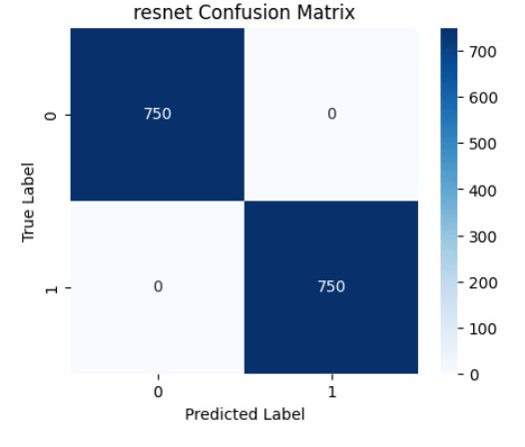
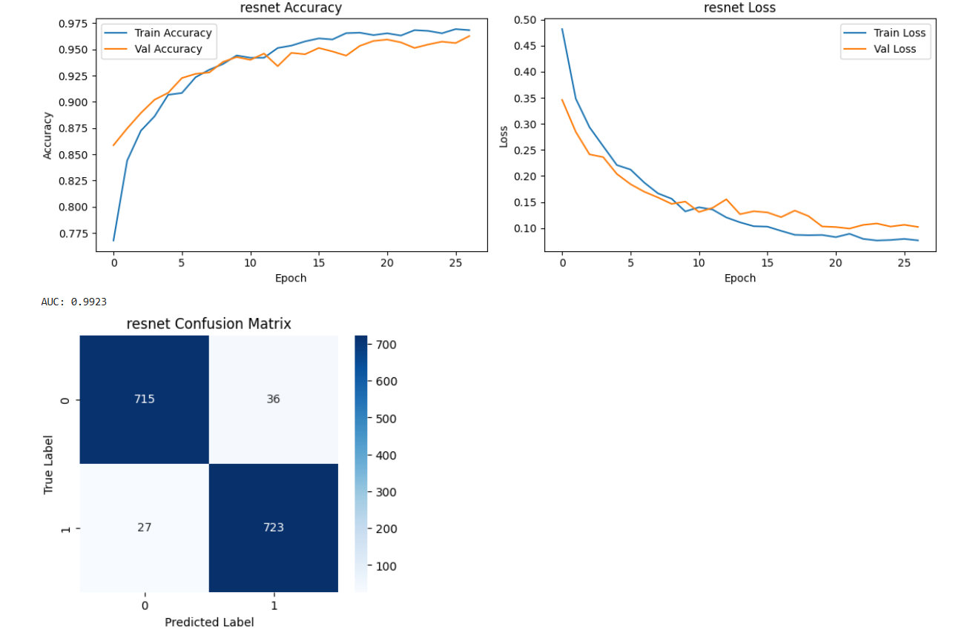
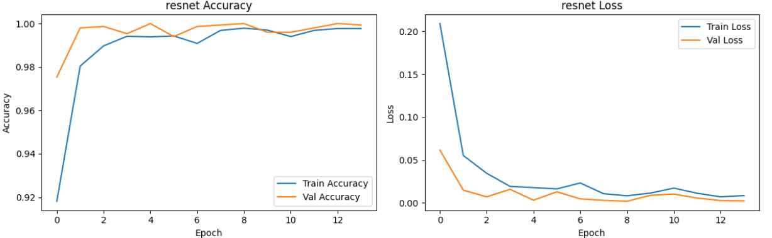
Foundation model - ResNet50
Multi cancer dataset
Line Scheuer, Sham Ayrouta and Valdemar Lund-Frank
Still, no improvement was observed during training of the CNN model on the kidney dataset. Using the original train-test split, we implemented a new model based on the ResNet50 architecture, using pre-trained weights to facilitate learning. The new model was also tried on the oral dataset.
Kidney
Oral
AUC: 1.00
AUC: 0.99
Training time: 5258 s

Slide 21
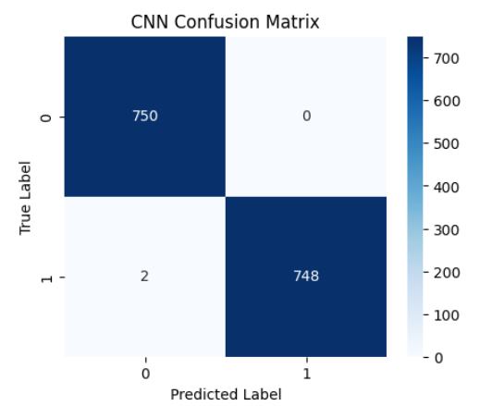
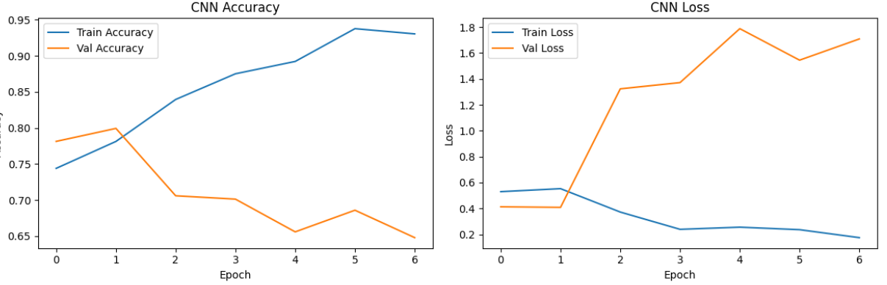
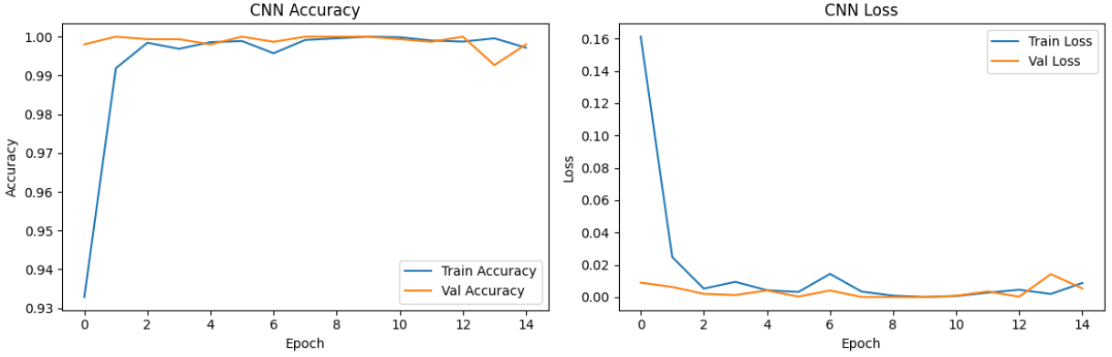
Data augmentation on kidney data
Multi cancer dataset
Line Scheuer, Sham Ayrouta and Valdemar Lund-Frank
A last thing that was tried to successfully train a model on the kidney data was the implementation of data augmentation.
Kidney – with data augmentation
Kidney – without data augmentation
AUC: 1.00
AUC: 0.92

Slide 22
Auto-encoding
Another approach to improve both the performance and training time of the initial CNN models on the three different datasets was to implement an autoencoder that compresses the raw images into a latent space representation. The set-up of the auto-encoder:
Input: Raw images of shape (224, 224, 3) (color) or (224, 224, 1) (greyscale)
Architecture:
Encoder: 2 × [Conv2D + ReLU + MaxPooling2D] blocks with 32 and 16 filters
Decoder: 2 × [Conv2D + ReLU + UpSampling2D] blocks with 16 and 32 filters, followed by 1 × [Conv2D + Sigmoid ] block with 3/1 filters for reconstruction
Training:
Trained on a subset (2000 images) of the dataset
Optimizer: Adam (learning rate = 0.001)
Loss: Mean squared error
Batch size: 16
Epochs: 15
Validation split: 0.1

Slide 23
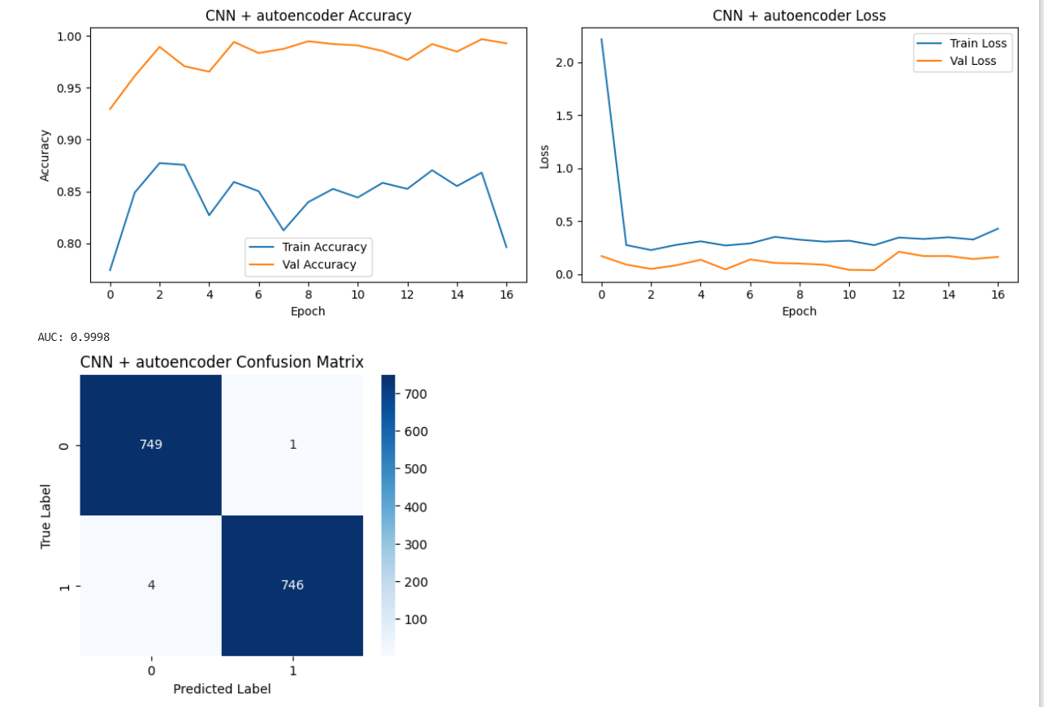
Initial CNN model on the encoded images
Multi cancer dataset
Line Scheuer, Sham Ayrouta and Valdemar Lund-Frank
The first basic CNN model was trained again on all datasets, but with the encoded images as input instead of the raw. The results were:
Oral
Breast
Kidney
AUC: 0.95
Training time: 102.21 sec
Best epoch: 11
AUC: 0.99
Training time: 141.06 sec
Best epoch: 16
AUC: 0.99
Training time: ?
Best epoch: 13

Slide 24
Auto-encoder with a dense layer
We then tried to add a dense layer to the auto-encoder to compress the latent space from (56, 56, 16) to (56, 56, 1) in the hope that compressing the features even further might improve the training process and time even more. The new autoencoder was implemented on the oral dataset and the basic CNN model was run on the encoded images:
Oral
AUC: 0.87
Training time: 173.20 sec
Best epoch: 14

Slide 25
Hyper parameter optimization
Since a great improvement in the training process and time of the basic CNN model on the oral dataset was seen when auto-encoding the images into latent space of (56, 56, 16), we wanted to try and improve the model even further. Therefore, Bayesian optimization was tried for this model:
Oral
Optuna Hyperparameter Optimization Setup:
Objective: Maximize validation AUC
Number of trials: 30
Hyperparameters tuned:
Learning rate in range [1e-5 : 1e-2]
Dropout rate in range [0.2 : 0.7]
Optimal HPs:
Learning rate = 0.0003
Dropout rate = 0.38
AUC: 0.98
Training time: 180.96 sec
Best epoch: 23

Slide 26
Grad-Cam and Score-Cam
Multi cancer dataset
Line Scheuer, Sham Ayrouta and Valdemar Lund-Frank
Grad-CAM and Score-CAM were applied to a CNN model trained on 10,000 autoencoded breast biopsy images. To ensure efficient runtime, the CAMs were computed on the encoded images. These representations were then decoded to approximate the original images, allowing the visual explanations to be overlaid the original image space.
Article for Score-Cam and Grad-Cam with comparison between different packages:
https://arxiv.org/pdf/1910.01279

